Slide 1
Coding Camp – Conformational Sampling
Yeonjoon Kim, Juan V. Alegre-Requena

Slide 2
Real Life Work
Your supervisor asks….
How do you do it?

Slide 3
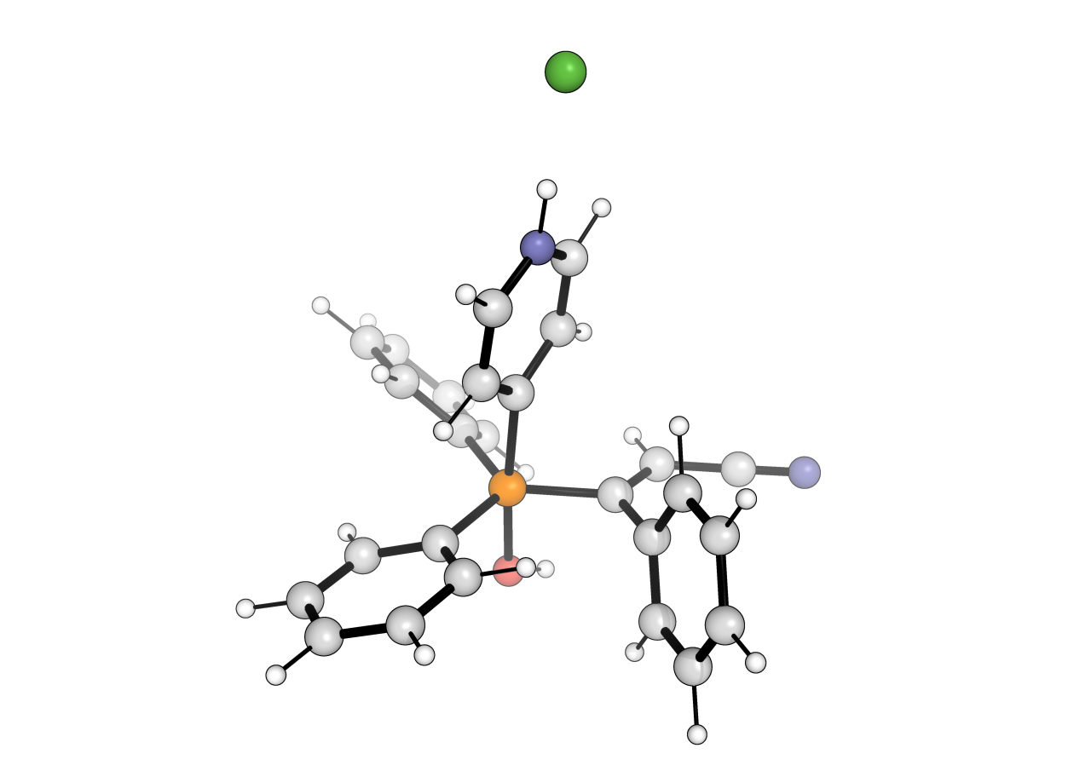

Real Life Work
Your supervisor asks….
Option 1: manually with GaussView
How do you do it?

Slide 4
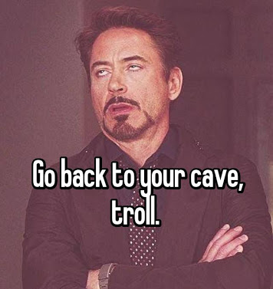
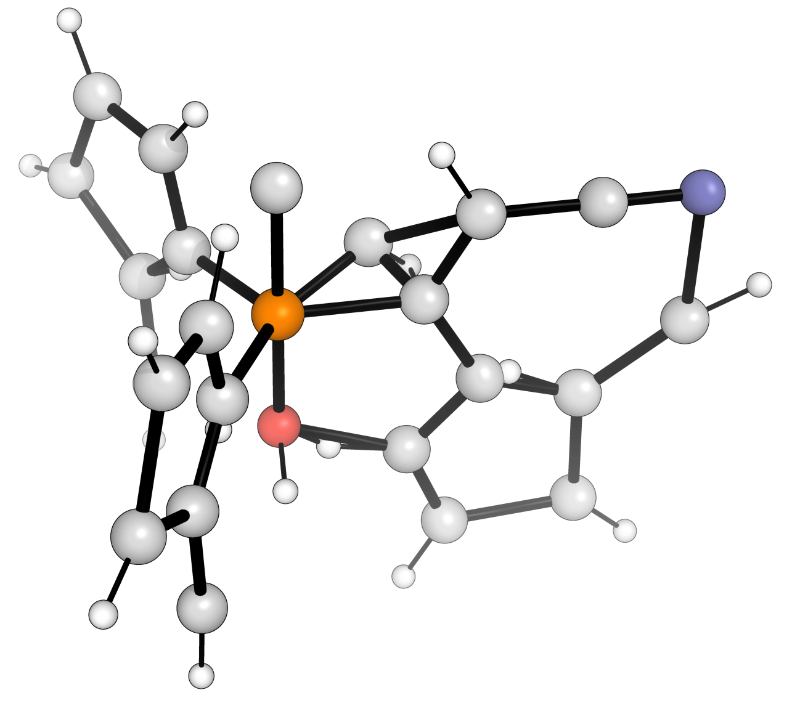
Real Life Work
Option 2: Openbabel or RDKit
obabel -ismi smiles.txt -oxyz -O file.xyz --gen3d -m
Your supervisor asks….
How do you do it?

Slide 5
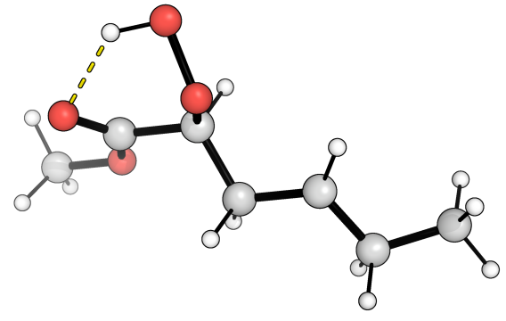
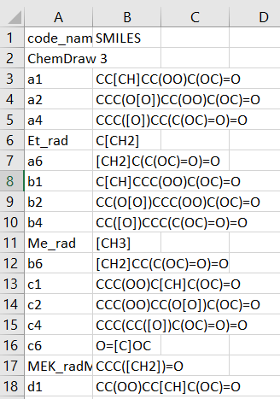
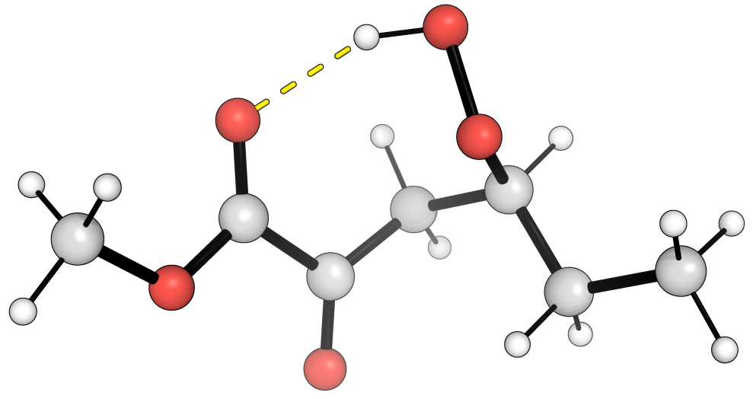
SMILES > PES
Automated computational protocols with pyCONFORT and GoodVibes
pyCONFORT
GoodVibes

Slide 6
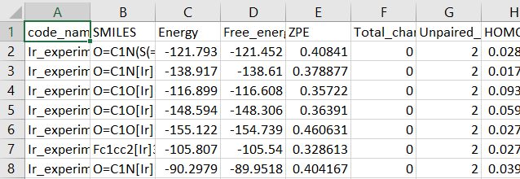
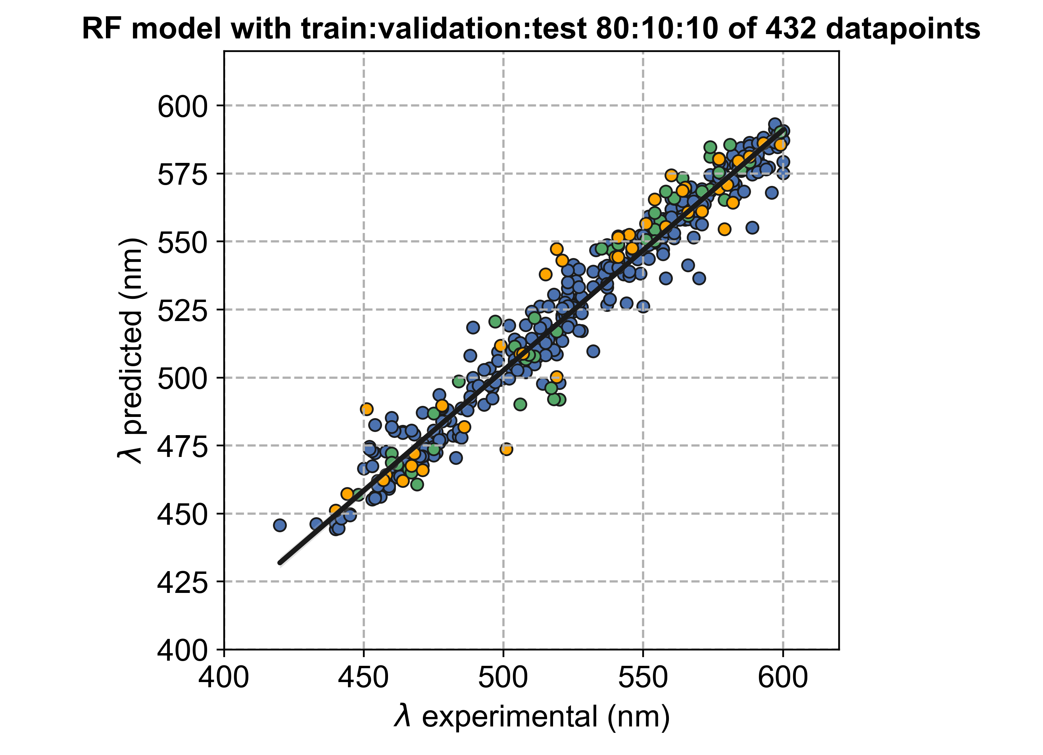
SMILES > Datasets
Automated protocols with pyCONFORT, disco-xTB and RF code
pyCONFORT
disco-xTB

Slide 7
Coding Camp – Conformational Sampling
Yeonjoon Kim, Juan V. Alegre-Requena

